Slide 1
Last Week
This Week
Asymmetry 2D Power Splitter
Symmetry 2D Power Splitter

Slide 2
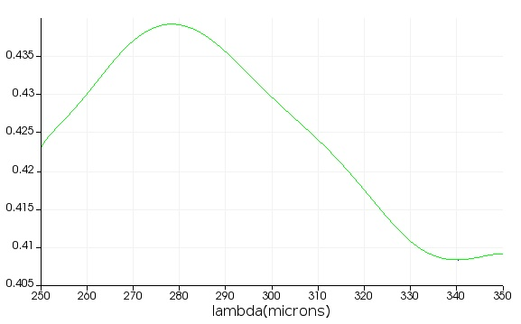
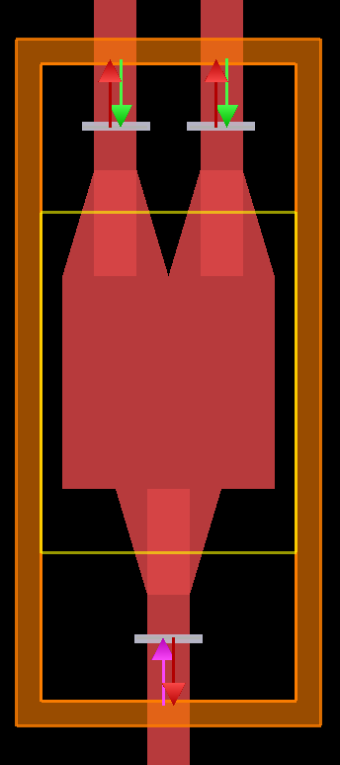
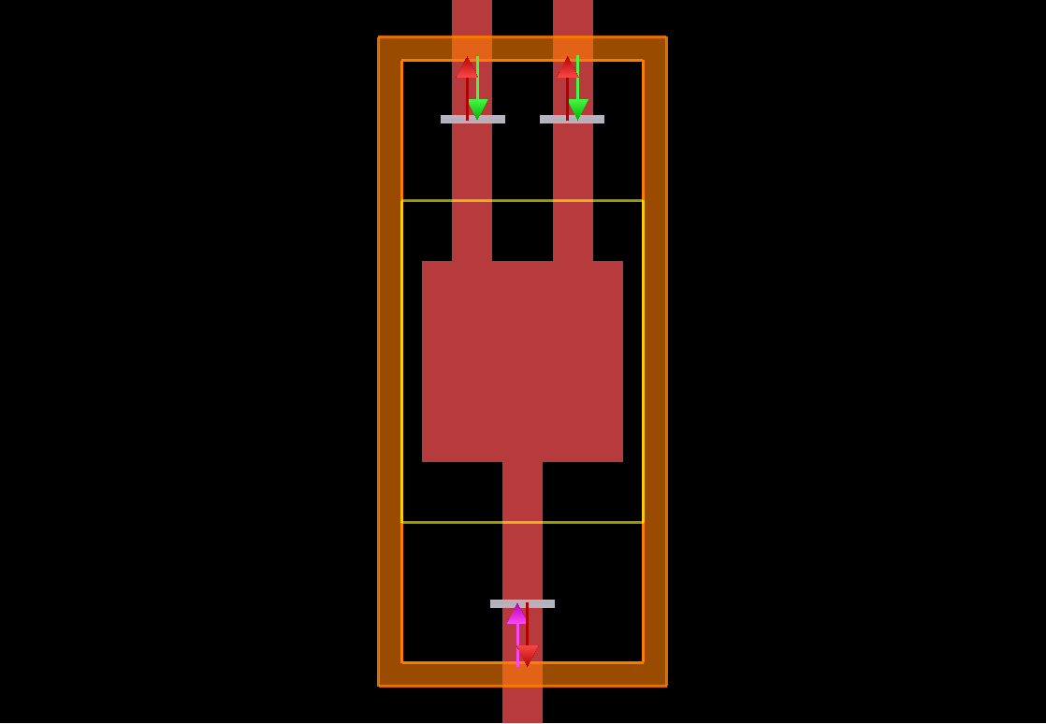
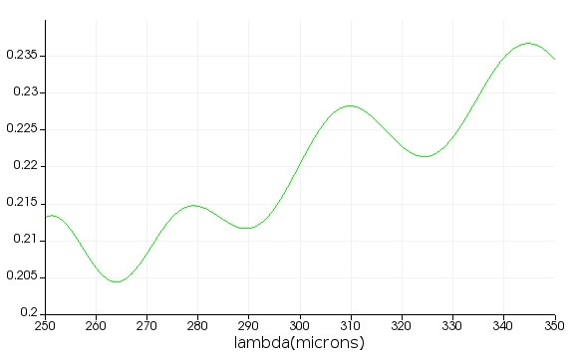
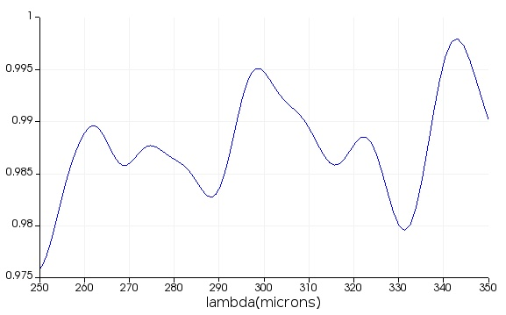
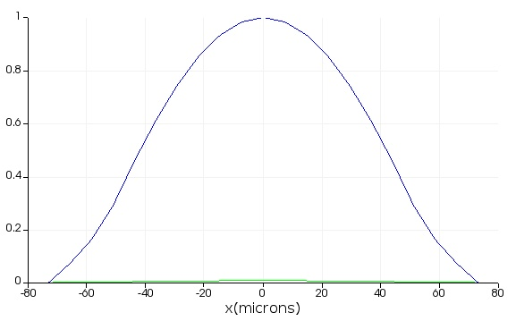
2D Power Splitter – FDTD Setting
Output 1&2
(b)-1
(a)-1
(a)-2
~ 0.4
(b)-2
~ 0.2
Simulation region: 250 ~ 350 um
Waveguide thickness: 100 um
Si Square: 500 um x 500 um
Taper connection: 250 um
Air Holes: 20x20 with a radius of 9 um
T_{input}
TE₁₀ mode

Slide 3
2D Power Splitter – Algorithm
ARLA (Additive Reinforcement Learning Algorithm)
Training
Data
(~ 40,000)
Result
Structure
Algorithm
T₁
T₂
Simulation region: 250 ~ 350 um
FOM = min(T₁) + min(T₂) -> maximize FOM

Slide 4
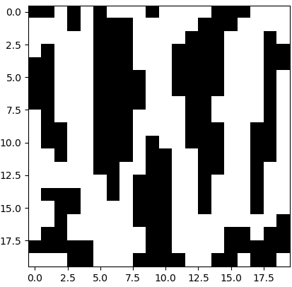
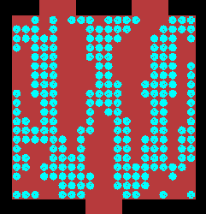
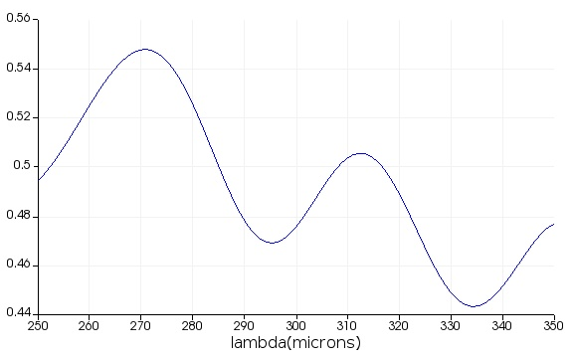
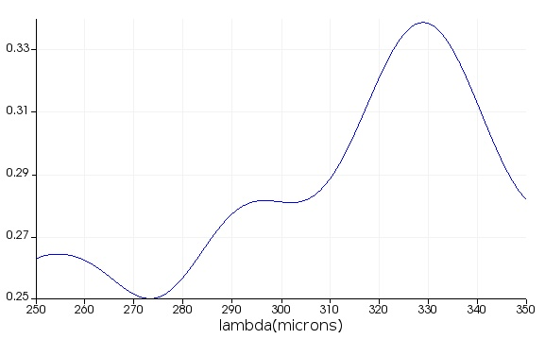
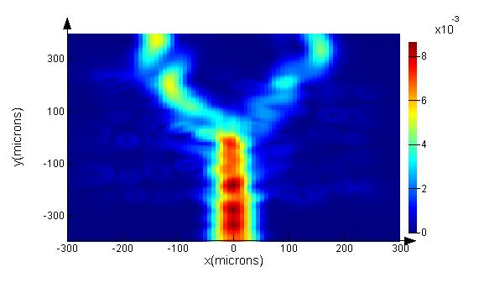
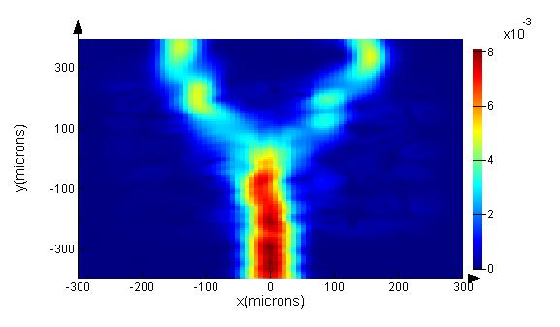
2D Power Splitter – Result
T₁
T₂
T₁
T₂
Power - 300 um
Power - 330 um

